Slide 1
JDBC and Hibernate
-Vasanth S
GeeksGd

Slide 2
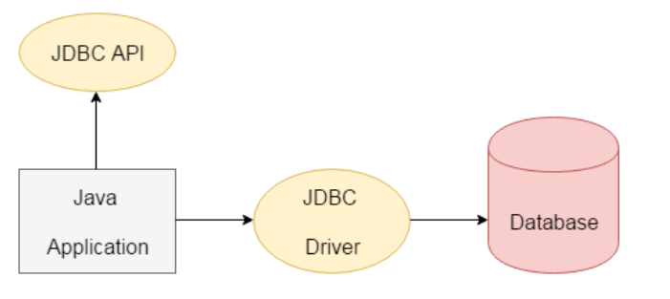
What is JDBC?
JDBC stands for Java Database Connectivity. JDBC is a Java API to connect and save, update, delete and fetch data from the database.

Slide 3
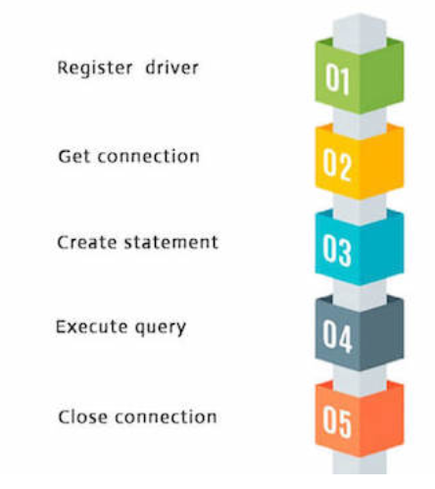
Seven Steps To Follow in JDBC
1) Import the package.
2) Register the drivers.
3) Establish a connection.
4) Create a statement.
5) Execute the query.
6) Process the results.
7) Close the connection.

Slide 4
Driver and Connection URL in MySQL
Driver class: The driver class for the mysql database is com.mysql.cj.jdbc.Driver.
Connection URL: The connection URL for the mysql database is jdbc:mysql://localhost:3306/dbname
Username: The default username for the mysql database is root.
Password: It is the password given by the user at the time of installing the mysql database. In this example, we are going to use root as the password.

Slide 5
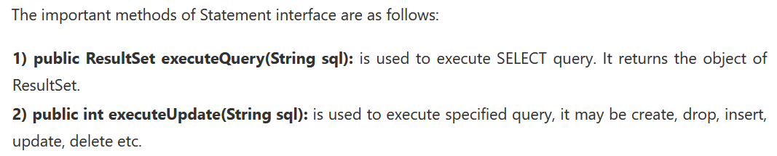
Statement Interface
The Statement interface provides methods to execute queries with the database.
The statement interface is a factory of ResultSet i.e. it provides factory method to get the object of ResultSet.

Slide 6
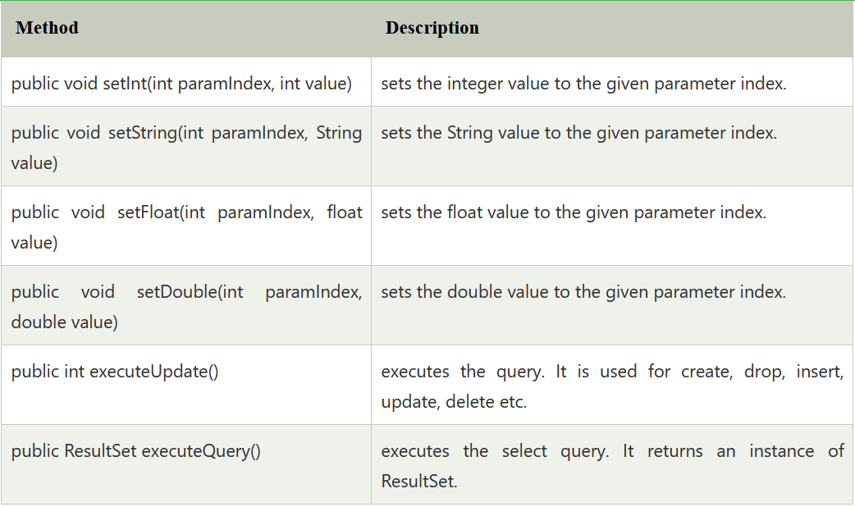
Prepared Statement
The PreparedStatement interface is a subinterface of Statement. It is used to execute parameterized query.

Slide 7
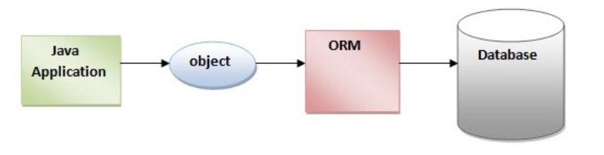
Hibernate Framework
Hibernate is a Java framework that simplifies the development of Java application to interact with the database.
It is an open source, lightweight, ORM (Object Relational Mapping) tool.
Hibernate implements the specifications of JPA (Java Persistence API) for data persistence.

Slide 8
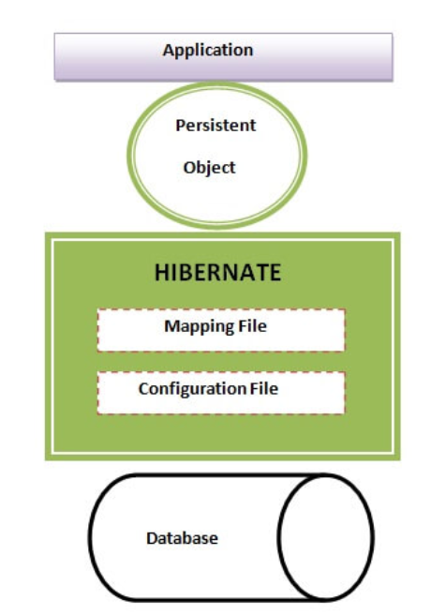
Hibernate Architecture

Slide 9
HQL
All CRUD operations in Hibernate must be done within transactions.
Hibernate Query Language (HQL) is same as SQL (Structured Query Language) but it doesn't depends on the table of the database.
Instead of table name, we use class name in HQL. So it is database independent query language.
There are many advantages of HQL. They are as follows:
database independent
supports polymorphic queries
easy to learn for Java Programmer

Slide 10
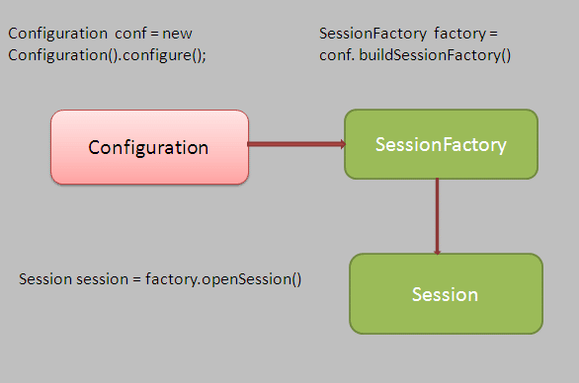
SessionFactory and Session

Slide 11
SessionFactory
SessionFactory is created at the time of application startup, it reads all information from the configuration file(hibernate.cfg.xml file).
We should have one SessionFactory for one database configuration.
We can create a SessionFactory object using the Configuration class as below.
SessionFactory sessionFactory = new Configuration().configure().buildSessionFactory();

Slide 12
Session
The main use of the Session object to perform create, get, and delete operations for java classes(entity).
We can have multiple sessions for a SessionFactory.
We can get Session object using SessionFactory reference as below.
Session session = sessionFactory.getCurrentSession();

